Slide 1
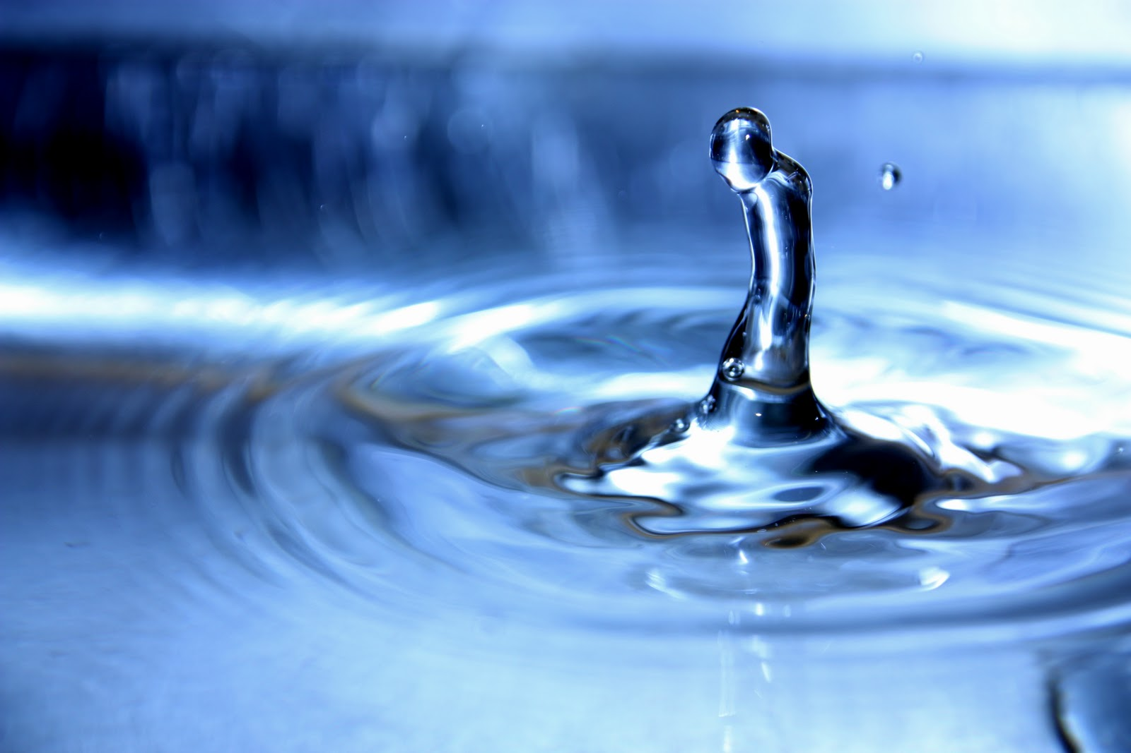
Water
Therese, Monica, Line og Christiane

Slide 2
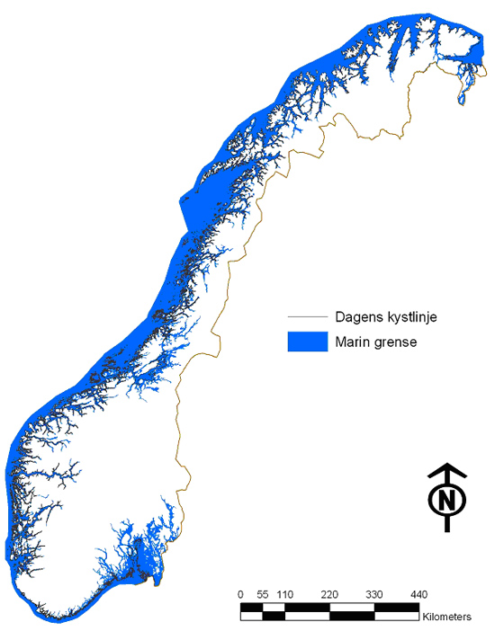

Slide 3
Content list
Problem: Which positive and negative sides does water have in Norway?
Fishing
Oil
Transport
Tourism
Hygiene
Energy
Natural disasters
Spread
Drowning
Sport activities

Slide 4
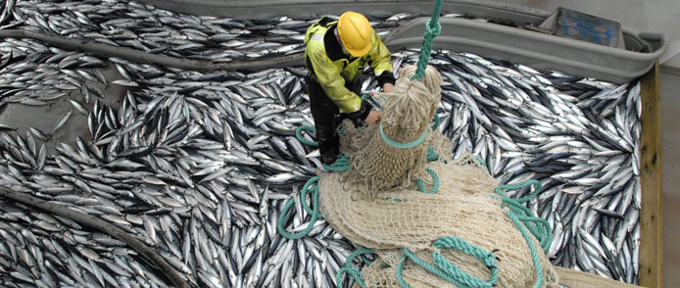
Fishing
Norway is a fishing nation
Norway regulates an area that is 6-7 times larger than the mainland
Most productive fish areas in the world

Slide 5
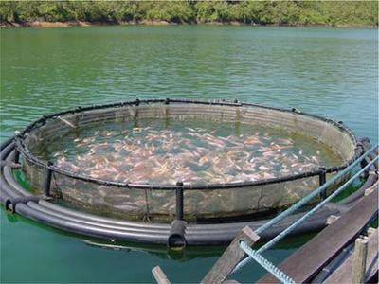
Modernized
More income

Slide 6
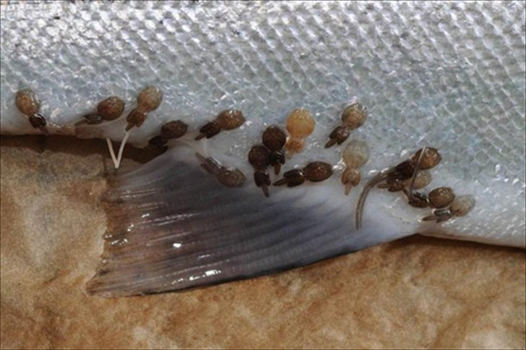
Negative effect
Fishresources are easy to be wounded
Conditional renewable resource
Lice
Escaping

Slide 7
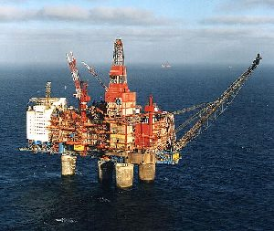
Oil

Slide 8
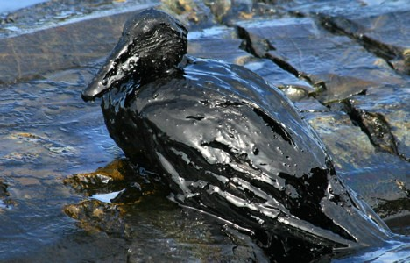
Negative effects
Oil spill
Acid rain

Slide 9
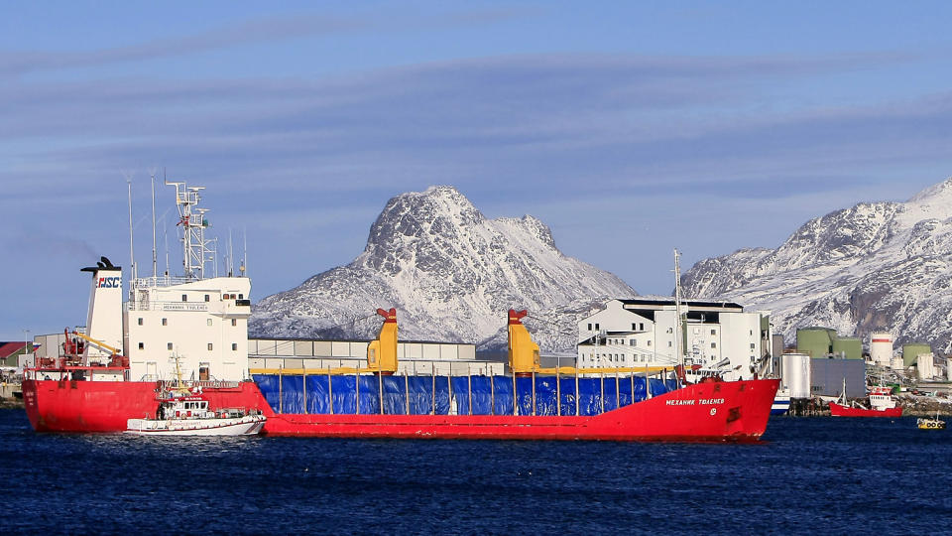
Transport

Slide 10
Tourism
Rang | Naturatraksjon | Sted | Fylke | Antall besøkende (2006)
1 | Vøringsfossen | Eidfjord | Hordaland | 655 000
3 | Kjosfossen | Flåm | Sogn og Fjordane | 457 400
4 | Geirangerfjorden | Geiranger | Møre og Romsdal | 423 643
5 | Låtefossen | Odda | Hordaland | 420 000
6 | Steinsdalsfossen | Norheimsund | Hordaland | 300 000
7 | Nærøyfjorden | Aurland | Sogn og Fjordane | 297 038
8 | Briksdalsbreen | Olden/Stryn | Sogn og Fjordane | 280 000

Slide 11
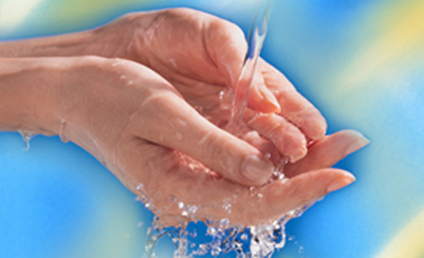
Hygiene
Good health
Shower, brush teeth..
Side effect-> overuse

Slide 12
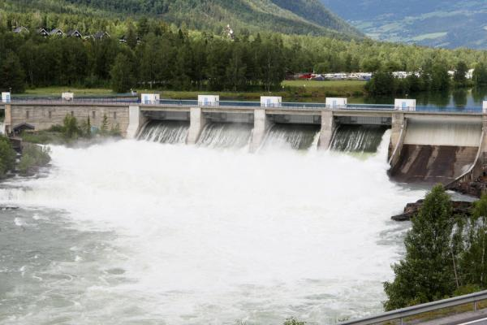
Waterpower/ hydropower
Main source to electricity
Renewable resource
Destroys the environment

Slide 13
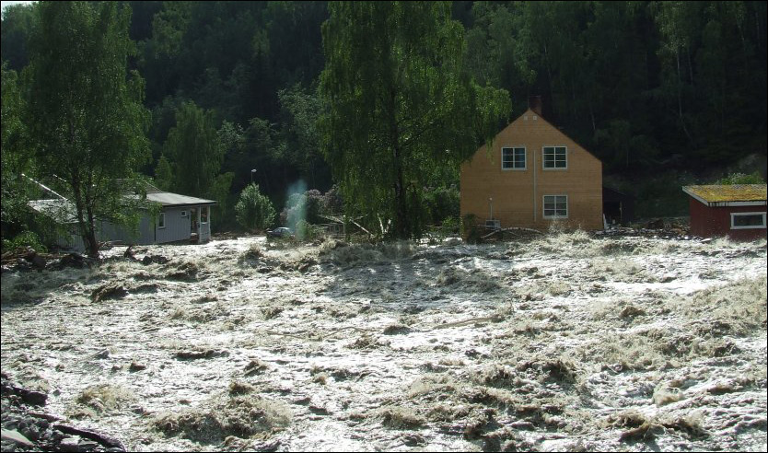
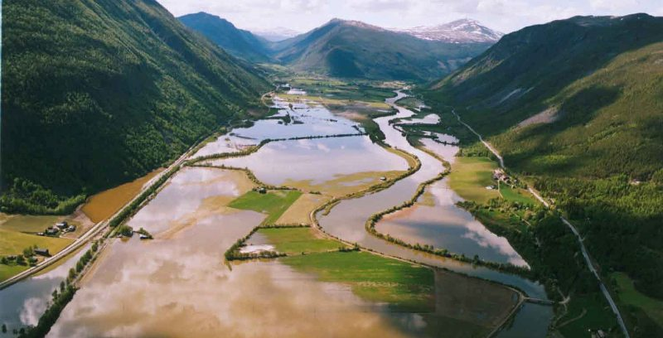
Nature disasters
Flood
10. June in Gudbrandsdalen

Slide 14
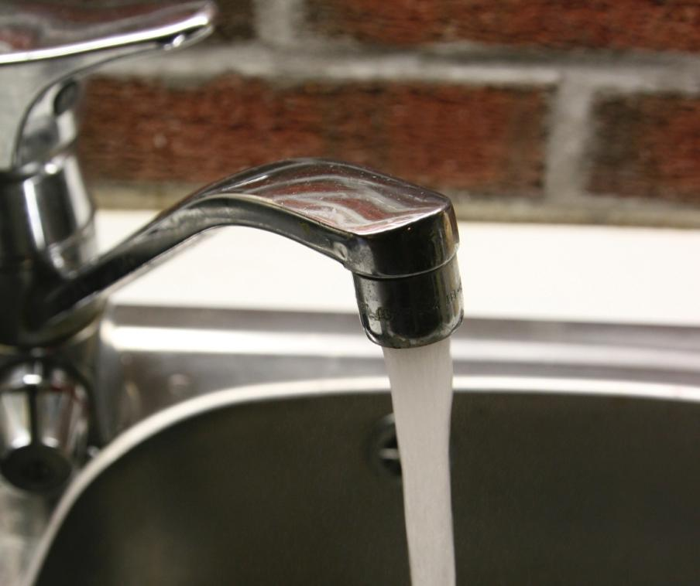
Spread
Bergen -> Giardia

Slide 15
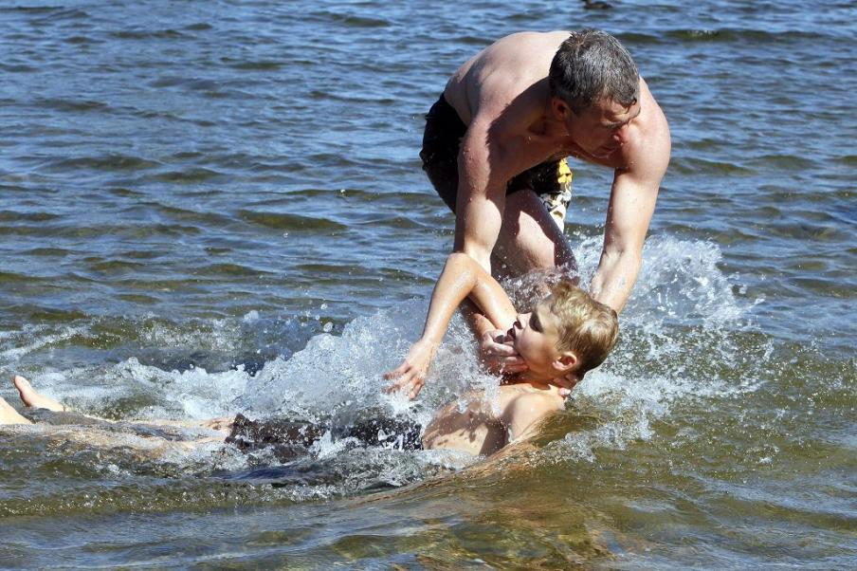
Drowning
79 deaths

Slide 16
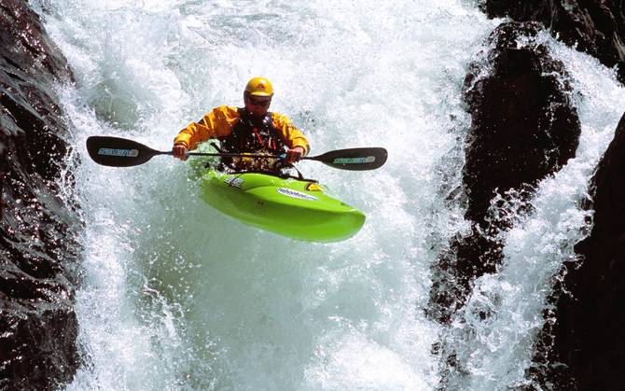
Sport activities

Slide 17
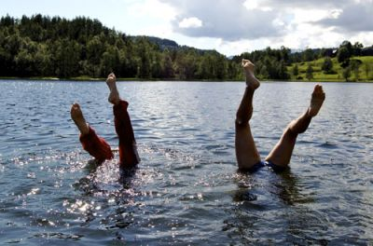
Conclusion

Slide 18
Takk for oss
Euxaristw gia tin prosoxi sou
Bizim icin tesekurler
Tack för oss!
Dziekuje
Grazie per la vostra attenzione
Gracias por su atencion
Thank you for your attention
G

